Slide 1
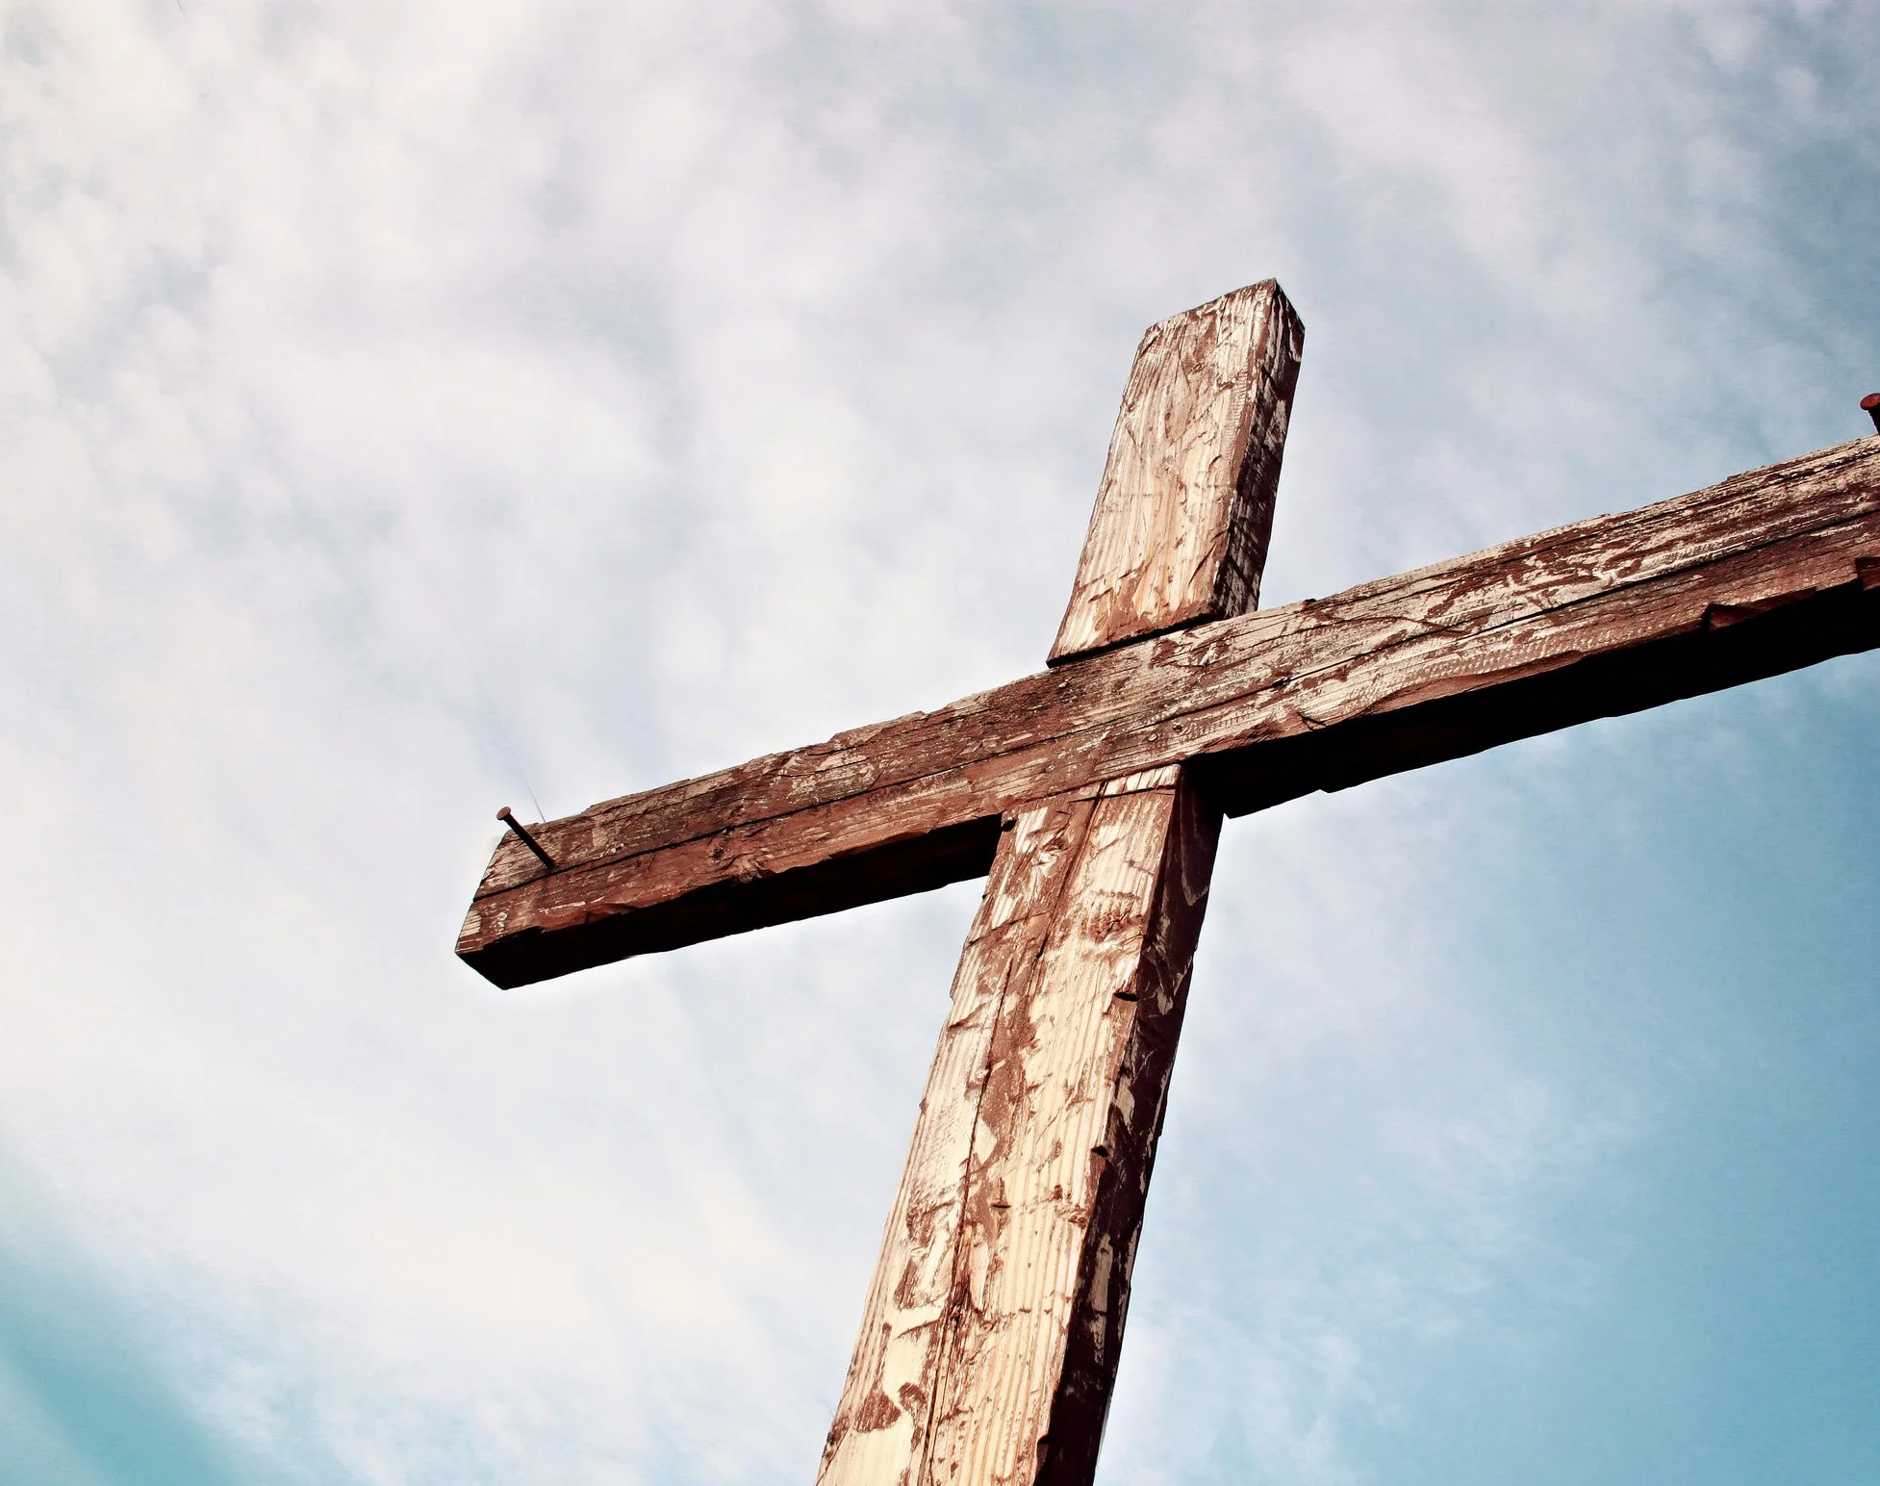
Praise To The Lord The Almighty

Slide 2
G Am Em
Praise to the Lord, the Almighty, the King of creation
G Am Em
O my soul, praise Him, for He is thy health and salvation
C D
All ye who hear, now to His temple draw near
C D G Am Em C
Praise Him in glad adoration

Slide 3
G Am Em
Praise to the Lord, Who o’er all things so wondrously reigneth
G Am Em
Shelters thee under His wings, yea, so gently sustaineth
C D
Hast thou not seen how thy desires e’er have been
C D G Am Em C
Granted in what He ordaineth?

Slide 4
G Am Em
Praise to the Lord, who doth prosper thy work and defend thee;
G Am Em
Surely His goodness and mercy here daily attend thee;
C D
Ponder anew what the Almighty can do,
C D G Am Em C
If with His love He befriend thee

Slide 5
G Am Em
Praise to the Lord, O let all that is in me adore Him
G Am Em
All that hath life and breath, come now with praises before Him
C D
Let the Amen sound from His people again
C D G Am Em C
Gladly for aye we adore Him

Slide 6
G Am Em
Praise to the Lord, the Almighty, the King of creation
G Am Em
O my soul, praise Him, for He is thy health and salvation
C D
All ye who hear, now to His temple draw near
C D G Am Em C (x2 end in G)
Praise Him in glad adoration
END

